Slide 1
Face Recognition App
Presented By: Lead Develop: Muhammad Saad Arif Dhillon
Collaborator: Umar Arif
Collaborator: Ali Ahmed

Slide 2
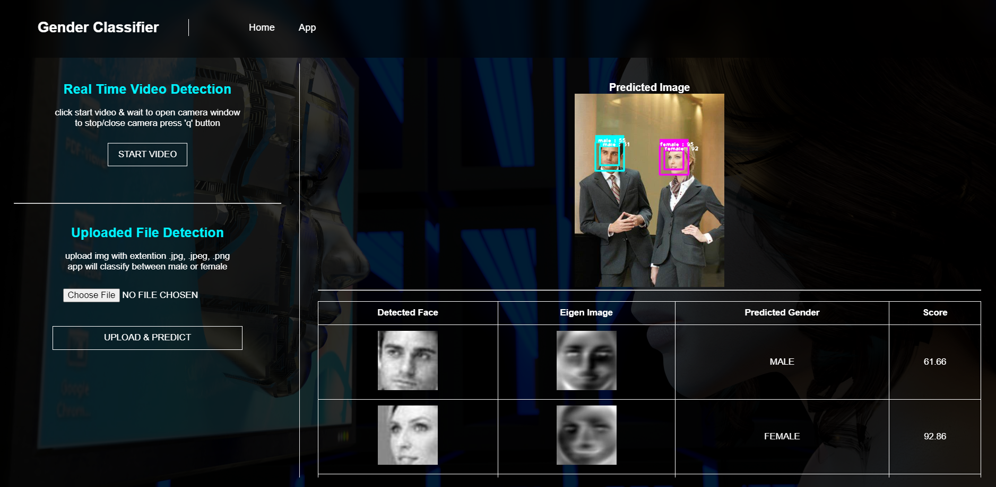

Slide 3
Steps
Data Analysis and Preprocessing
Training Machine Learning Model
Model Evaluation
Creating Pipeline Module
Testing Model with New Data
Real Time Video Detection
Integrating Model with Web App in Flask

Slide 4
Data Preprocessing
Detect Faces using Haar Cascade Classifier
Crop Faces from Images
Structuring Dimensions of Cropped Images
Data Analysis (charts)
PCA to extract features

Slide 5
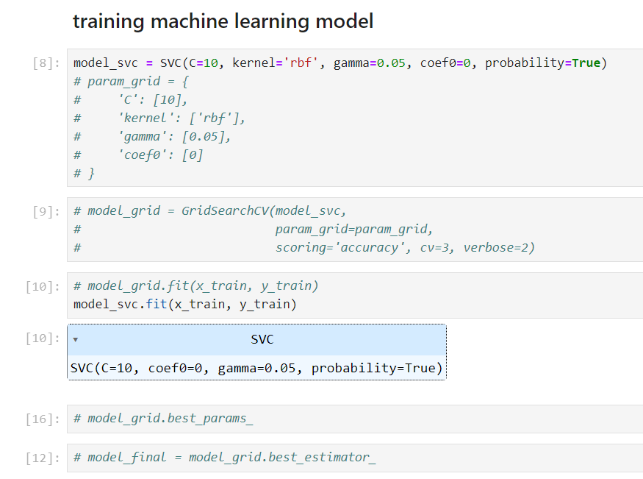
Training Machine Learning Model

Slide 6
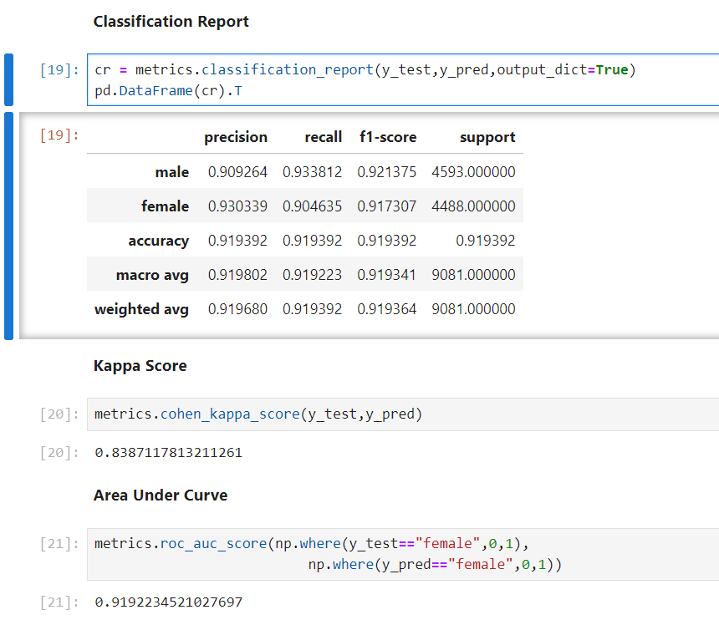
Classification Report Kappa Score AUC (area under curve)
Model Evaluation

Slide 7
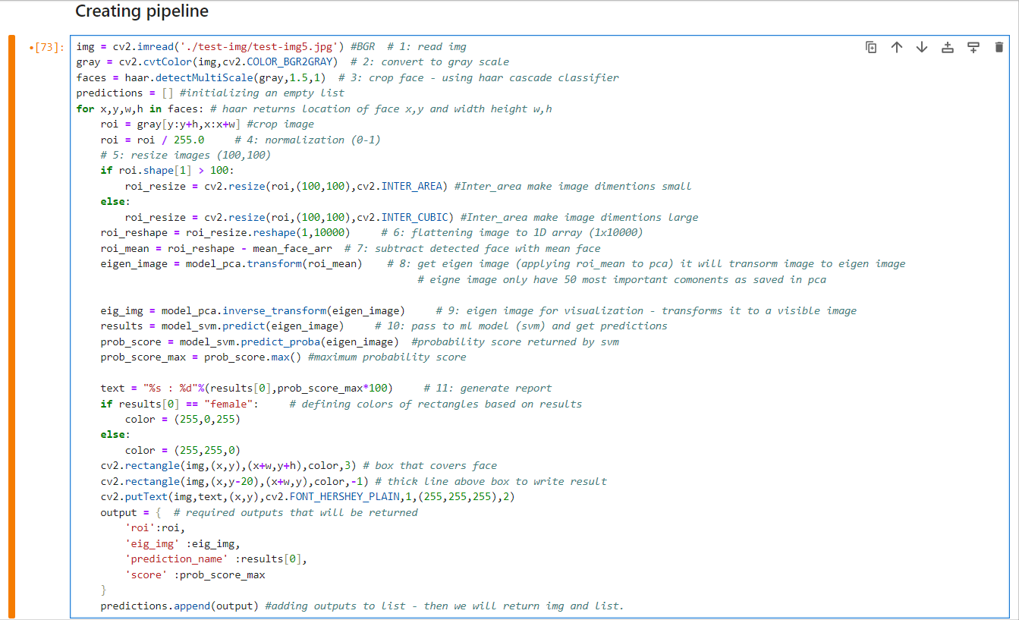

Slide 8
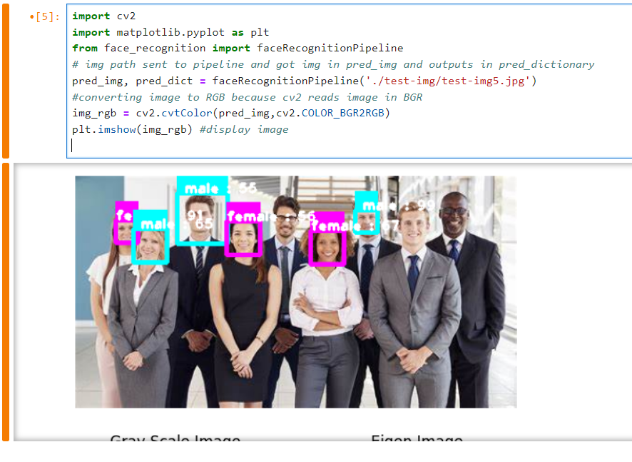
Testing Pipeline and Model

Slide 9
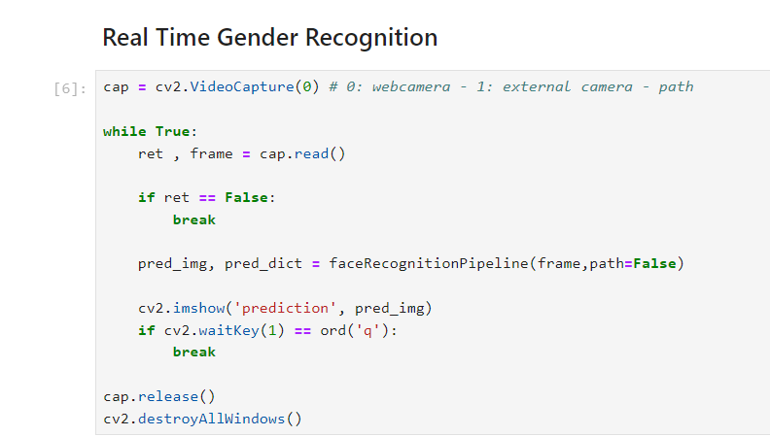
Real-Time Video Detection

Slide 10
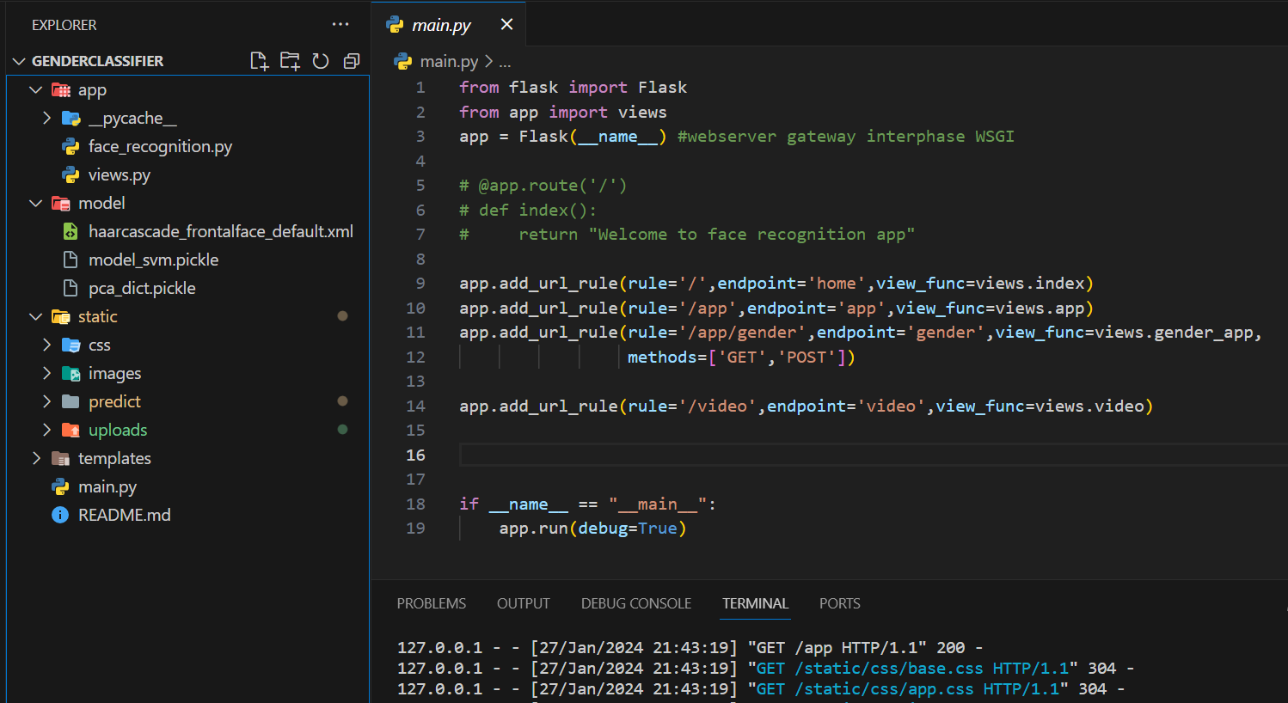
Integrating Everything to a Web App

Slide 11
Thank You ☺

